Slide 1
A Project on Wireless Communication using RF modulator and Encoder-Decoder
Presented by:
Fahmid mahmud id-1402042
md. Riazul mowla id-1402050

Slide 2
Components
RF Transmitter
HT12E Encoder
RF Receiver
HT12D Decoder
LM7805
Resistors (680kΩ, 33kΩ, 1kΩ)
Potentiometer (100kΩ)
LED
Connecting Wires
9V Battery

Slide 3
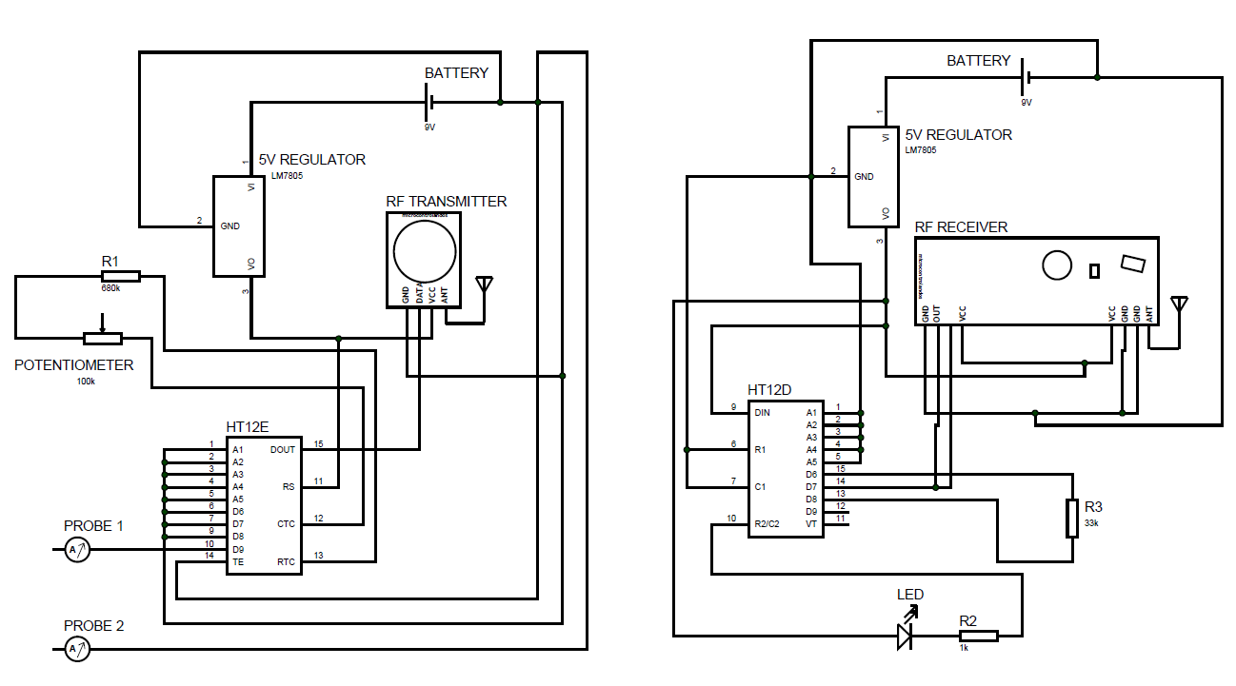
Schematic Diagram

Slide 4
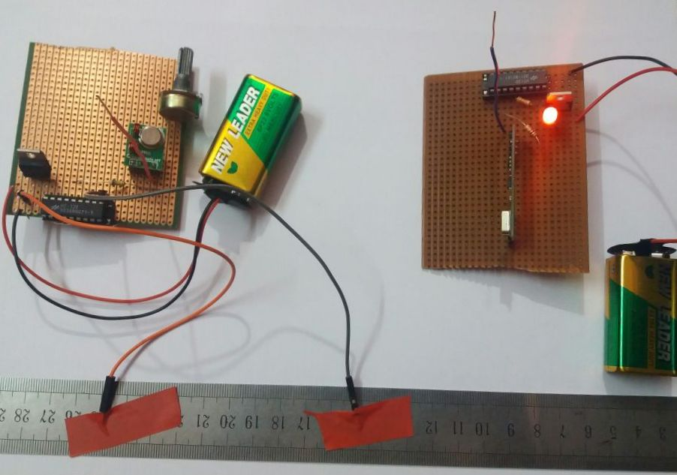
Vero-board Implementation

Slide 5
Working Principle of Used Module
The RF Transmitter & Receiver sections are placed at a distance of at least 20 meters. In order to show the working of wireless communication between transmitter & receiver, one LED at receiver side is controlled by an input terminal at transmitter section.
The HT12E encoder IC converts the single-bit data from the single data pin that are connected to button into serial data. This serial data is sent to RF transmitter. The RF transmitter transmits this serial data using radio signals.
At the receiver side, the RF receiver receives the serial data. This serial data is sent to HT12D decoder IC which converts into single-bit parallel data.
The single data pin of decoder are connected to a red LED through a 1kΩ resistor. According to the input terminal of transmitter circuit pushed, the LED can be turned ON or OFF.

Slide 6
Application of Wireless Transmission & Our Project
As RF modules doesn’t require line of sight communication, the transmitter & receiver can be isolated over a distance & data can be transmitted successfully.
The wireless transmitter & receiver can be used in car door & garage door controllers.
They can also be used in home automation systems.
Our project can be used in home for detecting the water level of water tank.
It can also be used for controlling gate OPEN or LOCK by detecting metal.

Slide 7
Conclusion
This project is one of the basic projects in the RF modules based electrical and electronic projects. This is the beginning of many more human-friendly and useful projects involving the amazing features of electrical components which are quite easily available.
From this project, we have learnt how to transmit a low power AM signal & how it receives by using RF modules. We have also learnt the working principle of TX & RX module and data sheet of HT12E encoder & HT12D decoder. Here we used LM7805 as a regulator to obtain 5V DC & a 100kΩ potentiometer for achieving the desired frequency.
In our daily life, we can use this project easily for our requirement purposes as it is much available. For further improvements like stable arrangements of the components, using precision components etc. will increase the efficiency of this project to a great extent.

Slide 8


